Slide 1
Do Convolutional Neural Networks Learn Class Hierarchy?
By Shubhankar Tripathi

Slide 2

Convolution neural network for image classification

Slide 3
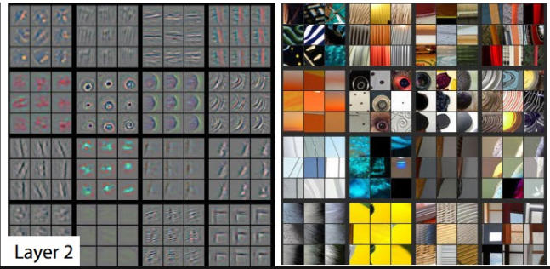
Visualizing Image Features
Understanding the image features.
Limited possibilities to improve performance.

Slide 4
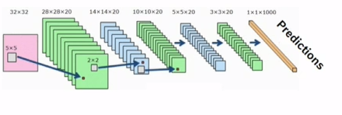
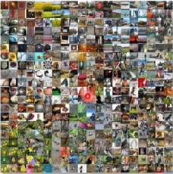
Visualizing Image Features
Model Appropriateness + training data quality

Slide 5
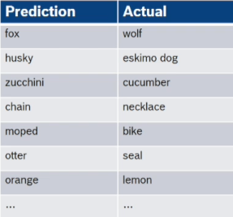
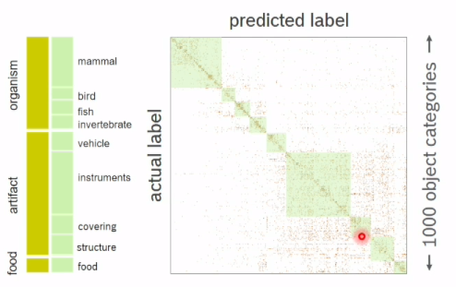
Classification Errors

Slide 6
Goal : Improve Performance
How do class confusions evolve during training?
Which feature characterize each group?

Slide 7
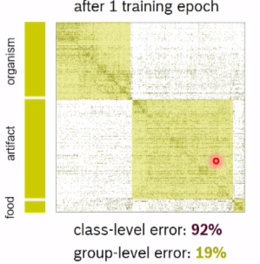
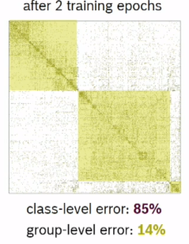
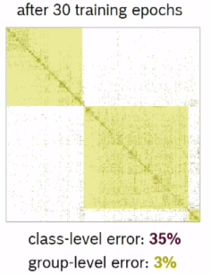
Evolution of Class Confusions
High level groups become separable very early

Slide 8
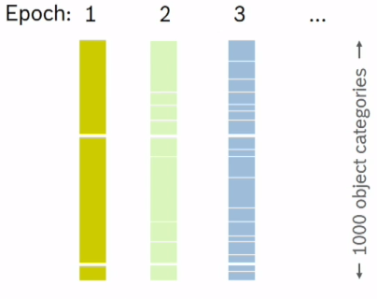
Evolution of Class Confusion
This is how class confusion evolve during training.
Subsequent epochs can separate finer and finer groups.

Slide 9
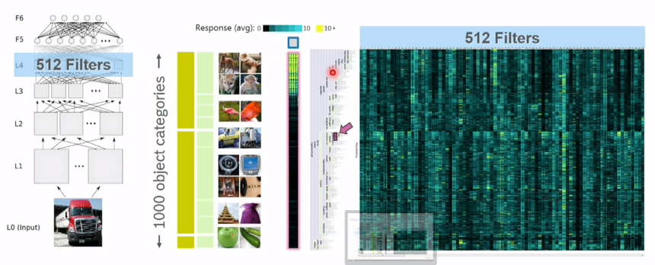
Group-level Features

Slide 10
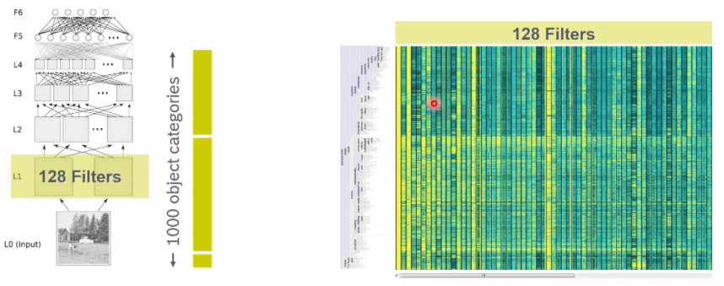
Group-level Features
Early layers can separate high-level groups

Slide 11
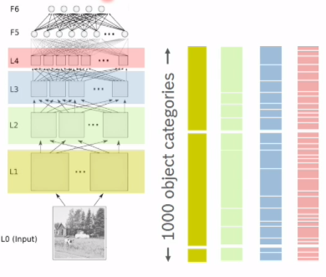
Feature Classification Power
Thus it’s clear how class confusions evolve during training.
Also it’s apparent which features characterize each group

Slide 12
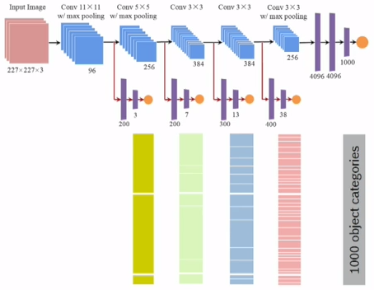
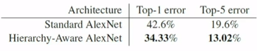
Hierarchy-Aware CNN’s

Slide 13
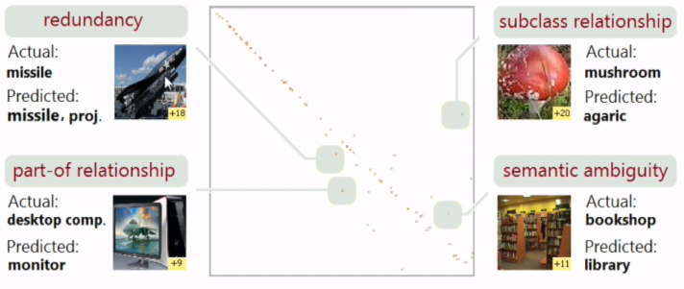
Inspecting Data Quality
Choice of classes -> inspect repititive confusions

Slide 14
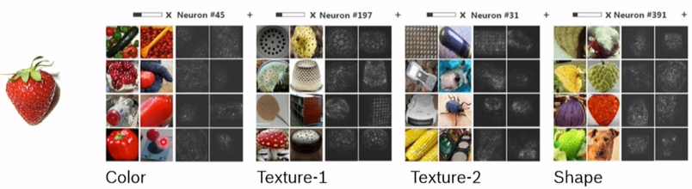
Inspecting Data Quality
Quality of features -> Inspect features that define a class

Slide 15
Benfits
The result is a generic too; to:
Refine the model to improve accuracy, convergence and generalization.
Find issues with classes and features.

Slide 16
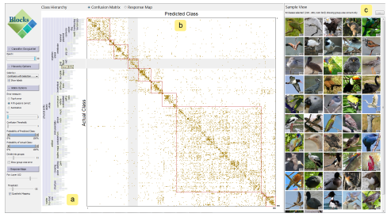

Slide 17

Thanks!

